Slide 1
Classifying animals
The importance of cognitive academic language and skills (or, talking and doing like a scientist)
Keith Kelly keith@anglia-school.info

Slide 2
Agenda
Linking language and thinking
‘Activity’ v passive learning
https://www.tigtagworld.com/ (CLIL versioning + ELTons)
Classification lesson and materials
Conclusion - importance of cognitive skills AND language development
Sorting-selecting, comparing/contrasting, classifying, identifying

Slide 3
Language and thinking
EFL largely concept-free
(where there are concepts, they tend to be random)
Anglia School themes (content AND language Integrated Learning)
What is the language of classification?
grouping (belongs to, is part of, comes from, goes with)
sorting (agreeing and disagreeing!)
comparing and contrasting (like, not like, different from, same as)
Similarity and difference (has, doesn’t have / has got, hasn’t got)

Slide 4
An example from Bulgarian (University)
What is in this text?

Slide 5
It’s a huge tree!
Pharmaceuticals, Categories and names of drugs

Slide 6
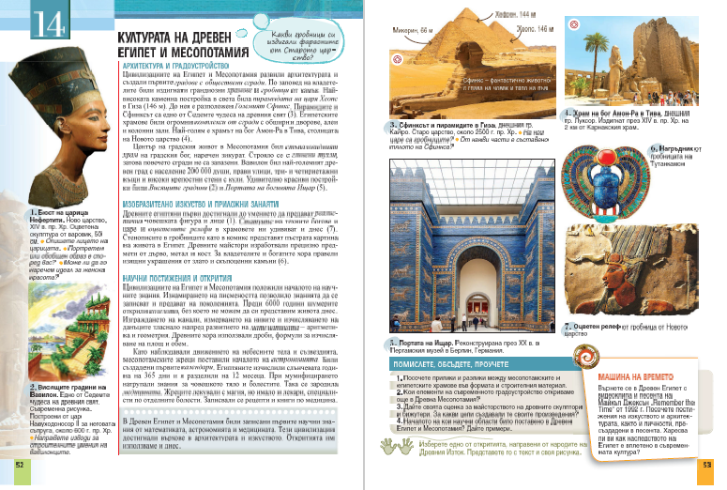
A second example from Bulgarian (Gr.5)

Slide 7
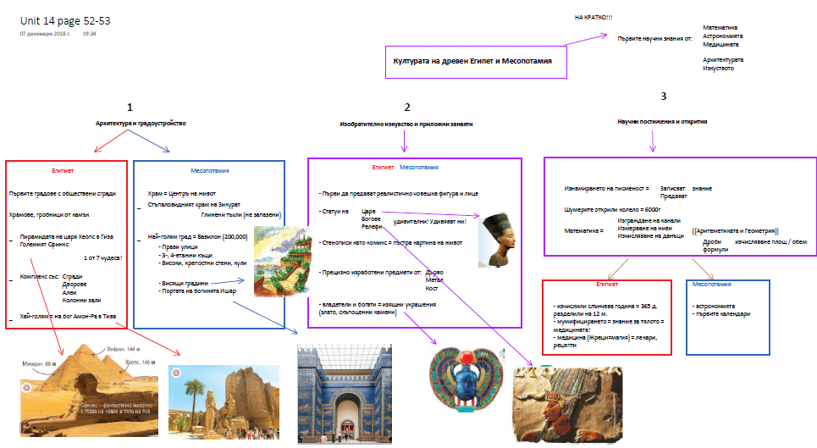
Ancient Egypt and Mesopotamia: Similarities and differences

Slide 8
Structure and Language – Make it visible!

Slide 9
TigTagWorld – A ‘visible’ curriculum

Slide 10
‘Activity’ v passive learning
Use ‘structure’ to create interaction and communication in lessons
Which word is the ‘odd one out’?
Group pictures of animals according to different characteristics
(fur, teeth, legs, wings, feathers).
Scientific classification tree can be used with youngest learners.

Slide 11
Lesson – classifying animals
Warm up – what’s in my bag?
Introduction - a classification tree

Slide 12
Fur or feathers?
Skins vocabulary

Slide 13
Same or different? A white tiger

Slide 14
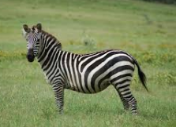
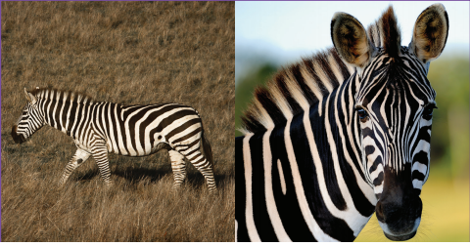
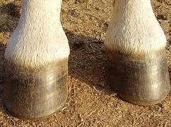
A zebra

Slide 15
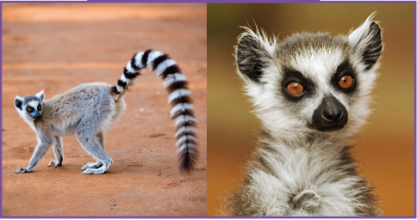
A ring-tailed lemur

Slide 16
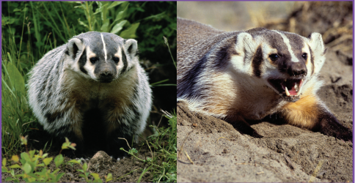
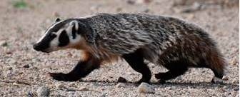
An American badger

Slide 17
Same or different?
Identifying same v different characteristics
Snout and fur

Slide 18
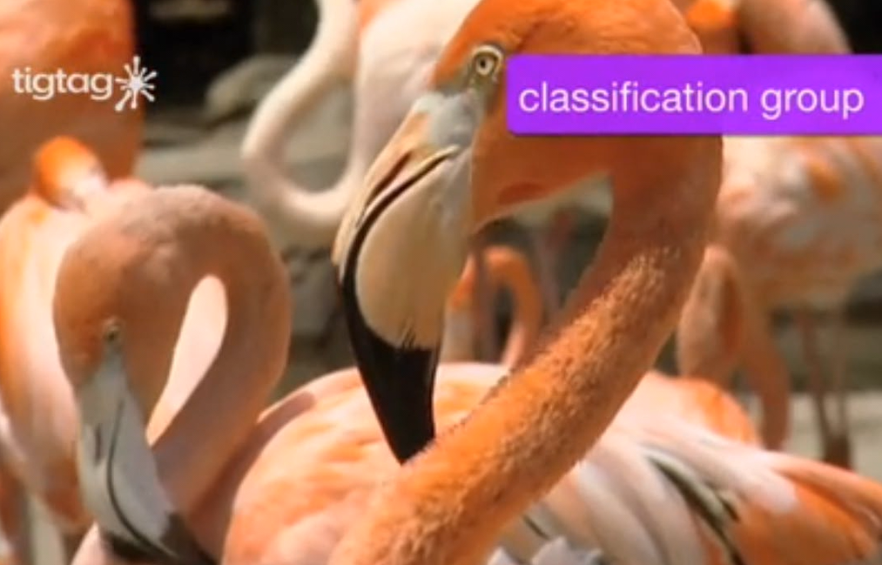
A new arrival at the zoo!
What animal is it?

Slide 19
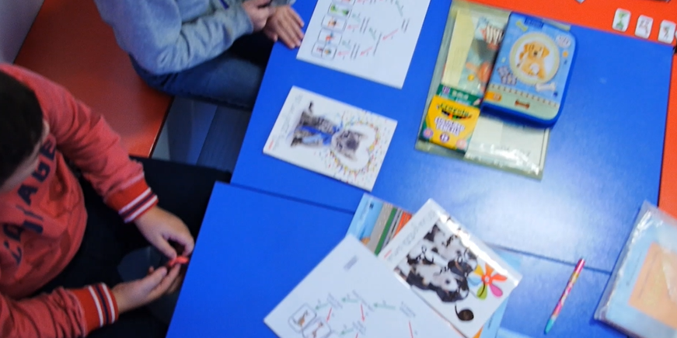
Classification game
Explaining the rules
Does it have glasses?
Answers

Slide 20
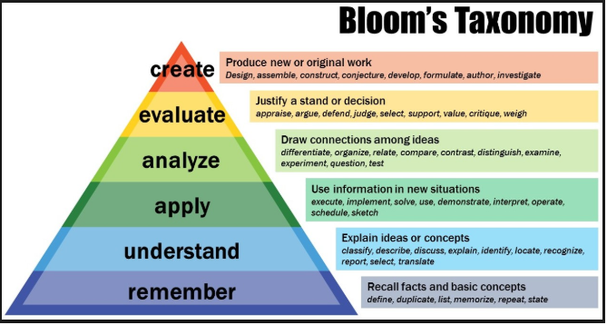
Conclusions and thoughts
Cognitive development AND language development
Bloom and classification, compare-contrast, group discussion, agreeing-disagreeing, sorting

